Slide 1
FOSS / Linux News!
2024.10.09

Slide 2
Linux Plumbers Conference 2024
Sept 18 - 20 in Vienna, Austria
Playlist of all presentations: https://www.youtube.com/playlist?list=PLVsQ_xZBEyN0XmmLaDFQEnuEu5HKSobpy

Slide 3

Python 3.13!
https://docs.python.org/3.13/whatsnew/3.13.html
New interactive interpreter
Improved error messages
CPython has experimental support for free-threaded mode, GIL disabled
Experimental Just-In-Time (JIT) compiler
Many other things, see the article for full list
Notes:
https://www.phoronix.com/news/Python-3.13-Released
https://docs.python.org/3.13/whatsnew/3.13.html

Slide 4
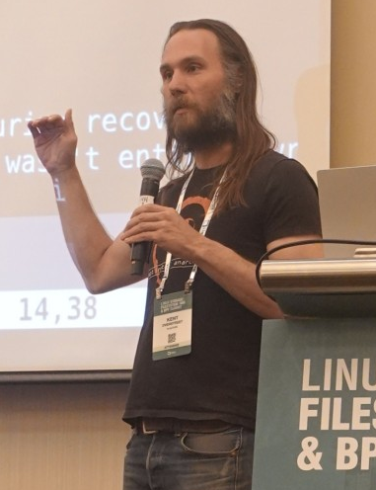
Linus Torvalds annoyed with bcachefs PR
“Bcachefs is an advanced new filesystem for Linux, with an emphasis on reliability and robustness and the complete set of features one would expect from a modern filesystem.”
https://lore.kernel.org/lkml/172816780614.3194359.10913571563159868953.pr-tracker-bot@kernel.org/T/
“You have exactly two choices here:
(a) play better with others
(b) take your toy and go home
Those are the choices.
Linus”
Notes:
https://www.phoronix.com/news/Bcachefs-Fixes-Two-Choices
https://lore.kernel.org/lkml/172816780614.3194359.10913571563159868953.pr-tracker-bot@kernel.org/T/

Slide 5

Nvidia publishes code for vGPU support
https://lore.kernel.org/kvm/20240924164151.GJ9417@nvidia.com/T/#m219a9503d570772306defac223545c006d43cb0a
Linux kernel patches to enable Nvidia vGPU software support
vGPU approach: Split a physical GPU into virtual GPUs that can be assigned to multiple concurrently running virtual machines
Notes:
https://www.phoronix.com/news/NVIDIA-Open-GPU-Virtualization

Slide 6

RISC-V Framework laptop
https://frame.work/blog/introducing-a-new-risc-v-mainboard-from-deepcomputing
“DeepComputing RISC-V Mainboard uses a JH7110 processor from StarFive which has four U74 RISC-V cores from SiFive”
Linux kernel starting to have patches to support this
Notes:
https://frame.work/blog/introducing-a-new-risc-v-mainboard-from-deepcomputing
https://www.phoronix.com/news/Linux-DT-Framework-13-RISC-V

Slide 7
Juno Tab 3 Linux Tablet
New Linux tablet - https://junocomputers.com/juno-tab-3/
Debian based Mobian Linux / Ubuntu 24.04 LTS
Intel N100 Celeron
12 GB LPDDR5 RAM
12.1” IPS touchscreen
Notes:
https://junocomputers.com/us/product/juno-tab-3/
https://9to5linux.com/juno-tab-3-linux-tablet-launches-at-699-with-ubuntu-24-04-lts

Slide 8

Winamp open sourced
https://github.com/WinampDesktop/winamp/issues
https://about.winamp.com/press/article/winamp-open-source-code
Notes:
https://junocomputers.com/us/product/juno-tab-3/
https://9to5linux.com/juno-tab-3-linux-tablet-launches-at-699-with-ubuntu-24-04-lts

